Slide 1
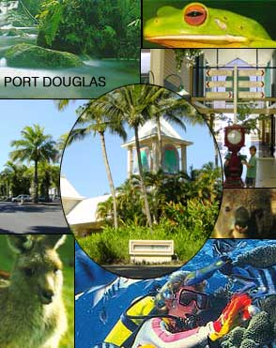
Place & Liveability
Introductory notes
There are so many different places where you could live:
Rural / Urban
Coastal / Inland
Small / Large
Bustling / Quiet
Give a location for each of the above.

Slide 2
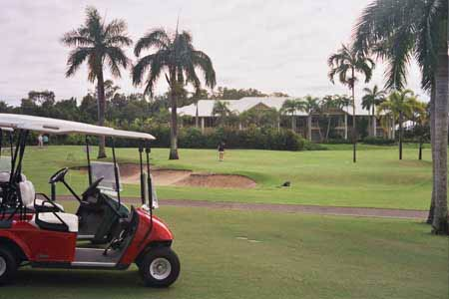
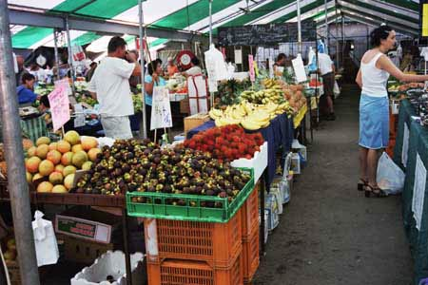
How can we make places more liveable?
This will be the major focus of our geography studies this term.
Our reference will be our text book and atlas

Slide 3
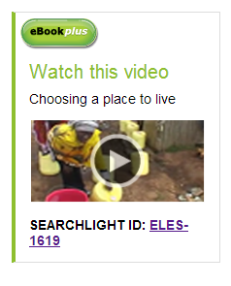
Consider why you live where you do?
Sub heading:
Video: Choosing a place to live
Write down 5 reasons why people live where they do from the video clip
Share answers and add to your own list
Refer Chapter 5 Page 101 of your Jacaranda eBook plus and watch the video:
Choosing a place to live.
Image above Hyperlinked.

Slide 4
What creates a sense of place?
Ref page 102 text
Notes:
To understand what a place is, one needs to consider it’s location and where it is in it’s region.
Each place has its own unique identity making it different from other places.
The characteristics of a place make a place different
Natural
Human
Combination of both.
Over time one of these characteristics becomes the distinctive feature of that place.

Slide 5
Activities page 103 Text Complete activity 1 by using a table & activity 2
Place | 1 | 2 | 3 | 4 | 5
Taj Mahal, Agra, India
Grand Canyon, Utah, US
Rio de Janiero, Brazil
Disney World, Florida, US
Table Mountain, Cape Town
Golden Gate Bridge
Great Wall of China

Slide 6

Discover: List your 5 favourite places in Australia.
Create a spreadsheet in your geography folder
Give it a title: Favourite places survey
Add the places that students give in the first column
Keep a tally in the second column
Remove all but three of your single entry places
Select your places and data
Go to ‘insert’ in the menu and select ‘chart’
A column graph would be best
Select ‘customise’ to make your graph look great and to ensure you have a title etc.
Notes:
The teacher should be doing this using the projector.

Slide 7
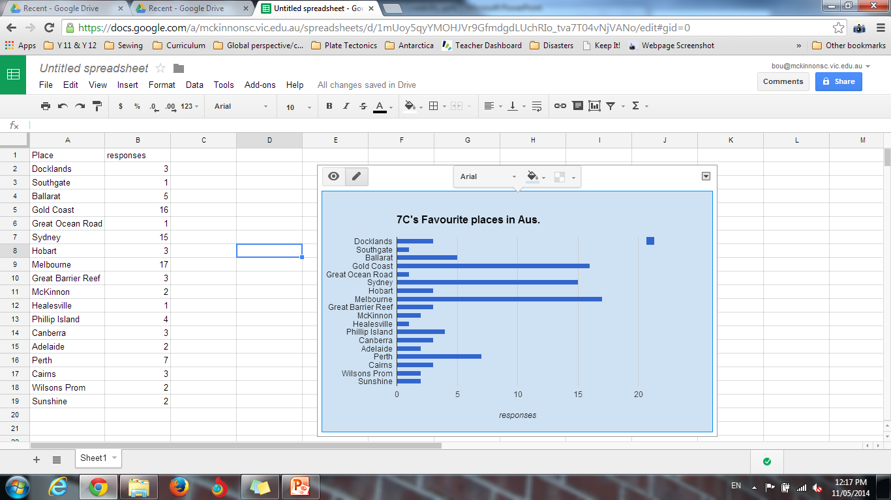
It should look like this.
Click on the chart and an arrow will appear in the top RHC.
Click on it and select ‘copy chart’

Slide 8
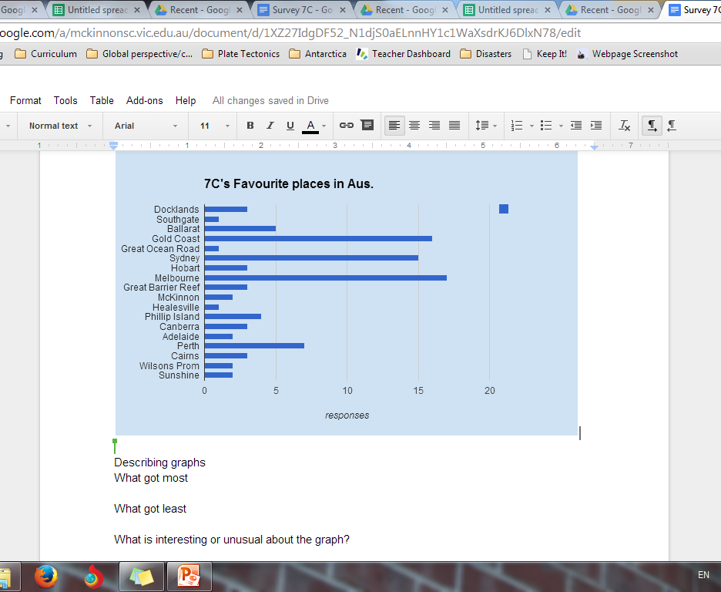
What next?
Create a “google doc’ in your Geography folder.
Give it a title ‘7C Favourite Aussie places survey”.
Paste your copied chart into the document.
Complete the 3 questions.

Slide 9
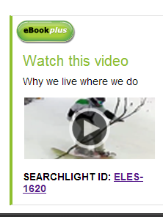
Why we live where we do.
Sub heading: Video
Jot down:
3 things you found interesting
3 things you did not know before
3 things that surprised you do.
Ref Ch 6 People & Places page 121 text.
Image above hyperlinked

Slide 10
Why do people live in certain places?
Ref page 104 text
Note taking
The reasons people live in different places can be divided into:
Pull factors
Push factors
Write out a definition for each see BRH corner page 105.
Reasons can change:
From person to person
Over time
Four factors that influence liveability:
Available resources
Employment
Relationships with other people
lifestyle
These factors can change throughout a persons life as they age and their needs change.

Slide 11
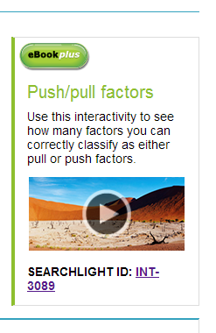
Complete the interactivity on push / pull factors Page 105 Text.
Image is hyperlinked

Slide 12
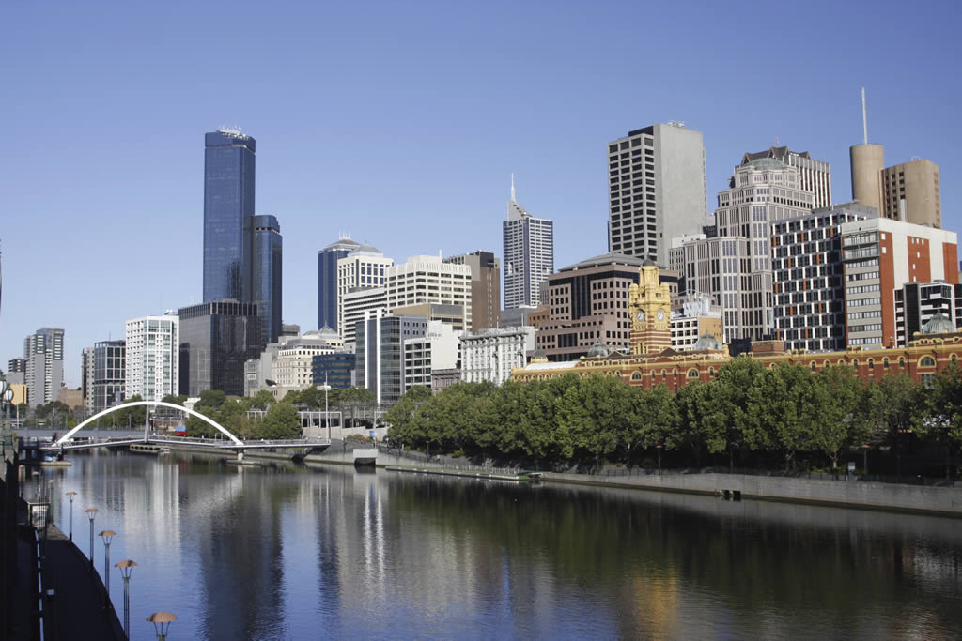
Where would you like to live?
Ref page 118 text
Read pages 118 & 119
Melbourne is ranked highly on world liveability by the Economist Intelligence Unit’s liveability survey.
http://edition.cnn.com/2013/08/28/travel/melbourne-most-livable-city/
What features of Melbourne
would make it rank so highly?

Slide 13
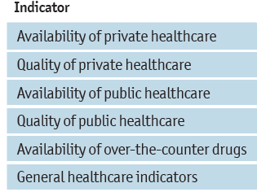
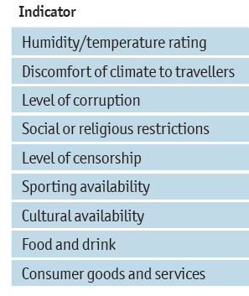
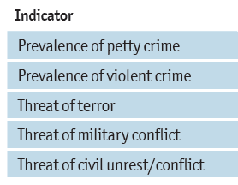
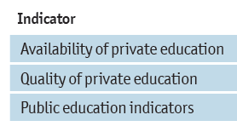
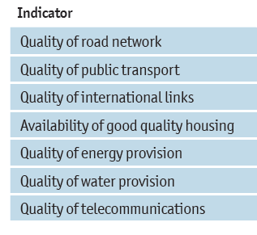
How does ‘The Economist Intelligence Unit’s liveability survey’ rank cities for liveability?
Criteria & weighting used:
Stability (25%);
healthcare (20%);
culture and environment (25%);
education (10%); and
infrastructure (20%).
Each factor in a city is rated as acceptable, tolerable, uncomfortable, undesirable or intolerable
Notes:
The PDF of this report is on the drive. Click to show the indicators used.

Slide 14
Lifestyle changes that impact where we live. Refer Text Chapter 5.9
Complete the ‘Predict’ activities page 119 in your notebook.
Define the following terms using the glossary in your text book
Sea change
Tree change
Liveable city
Neighbourhood
Urban decay

Slide 15
Where is my place & what makes it liveable? McKinnon/Bentleigh
Complete the table in your Geography folder
Feature | Where
Primary/ secondary school
Adventure play ground
Village style shopping strip
Large street shopping strip
Shopping mall
Corner shops
Parkland
Playing fields
Bike paths
Public transport

Slide 16
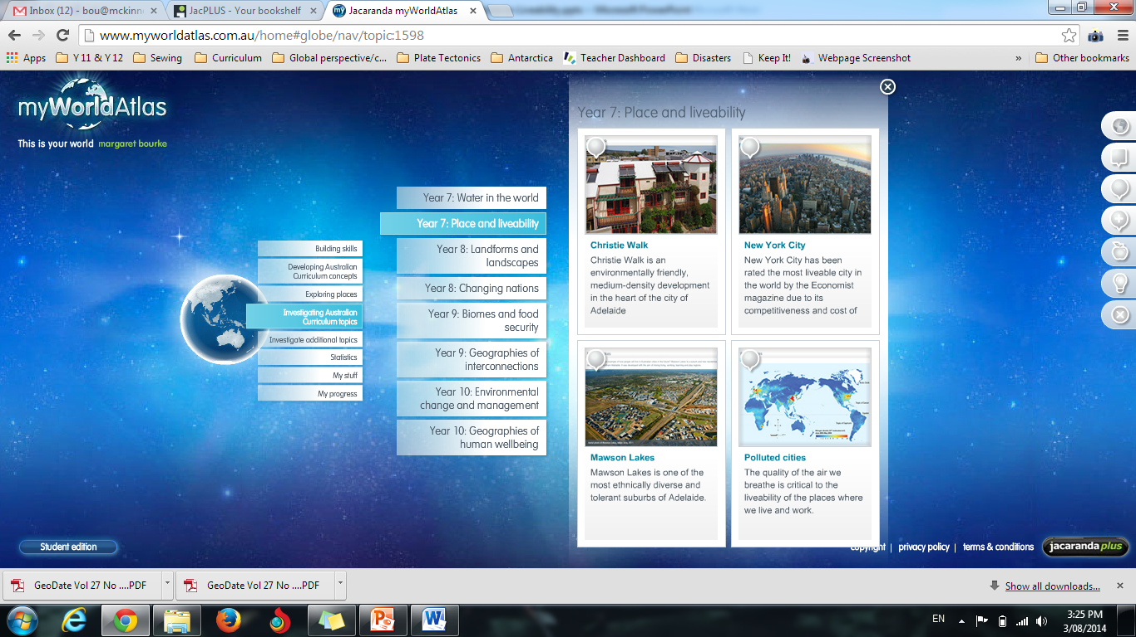
Select one of the locations and complete the tasks on line in you’re my World Atlas

Slide 17
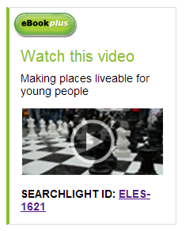
The liveability of our local neighbourhood: McKinnon/Bentleigh
Using the features listed in the table already completed nominate by a tick the features of the neighbourhood that make it:
safe,
easy to get around,
interesting,
makes people happy to
live there.
Watch the video after the brainstorm
Can you add to your list?
Ref page 135 Ch 7 text for video link.
Image above is hyperlinked
Notes:
Prompts/hints from the teacher would be to suggest aspects of, environmental quality, crime and safety, education and health provision, access to shops and services, recreational facilities and cultural activities as identified in the definition of liveability above. Specific examples could be safe crossings, trees, skate parks, bike lanes, nice houses, places for adventures, safe roads (e.g. slow traffic speed), good public transport, interesting streets and public spaces etc.

Slide 18
In Groups of 4: Using the ‘Placemat’ each student writes down 5 of what they believe are the most important factors/features, which make a community a safe and happy place in which to live. Negotiate an agreed list.
Agreed list
5 individual
5 individual
5 individual
5 individual

Slide 19
Class sharing of group work
Student groups share their 5.
Teacher and students create a list using a google doc, repeating the words used by the students.
Create a Word Cloud using one of the web sites below
Websites for Word Cloud:
www.wordle.net/create
www.abcya.com/word_clouds.htm
http://worditout.com/word-cloud/make-a-new-one

Slide 20
Create a class definition of liveability
Definition from Aus Curriculum:
An assessment of what a place is like to live in, using particular criteria, for example, environmental quality, crime and safety, education and health provision, access to shops and services, recreational facilities and cultural activities
Check out the definition on Page 138 of your textbook.

